Slide 1

Artificial Intelligence and ChatGPT

Slide 2
What you are going to see today
Some of the AI that is available for use today.
Some implications of the AI and ChatGPT
Experimenting with ChatGPT
Using ChatGPT to help with programming
Some Code to access ChatGPT and Other AI services

Slide 3
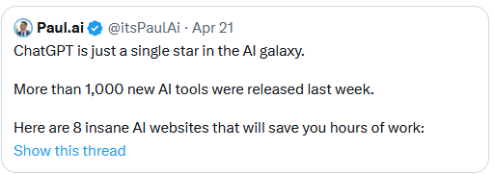
Growth of Artificial Intelligence

Slide 4
Near-Term Implications of Advances in AI
Education
Students will use it for assignments
Teachers will use it for making lesson plans
Call Centres
Employees replaced by AI
Knowledge industries will be transformed

Slide 5
Near-Term Implications of Advances in AI
Programming
Great potential to improve productivity
Smarter Personal Assistants compared to Siri, Alexa, etc

Slide 6
Negative Consequences of AI
Email SPAM
Scammers will use it to create custom messages for people
Scam phone calls by AI using voice recognition and text to voice
Deep-Fakes – Can you trust Photo’s, Videos, or Audio recordings ever again?
Possible inability to know why a decision was made.

Slide 7
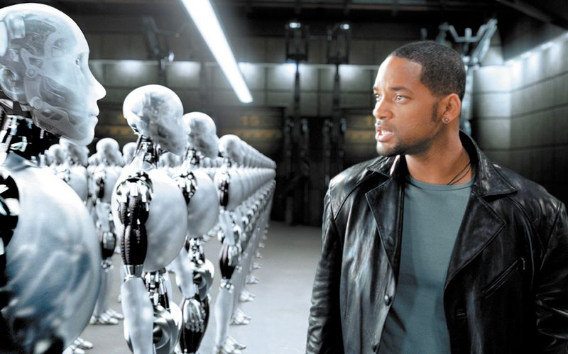
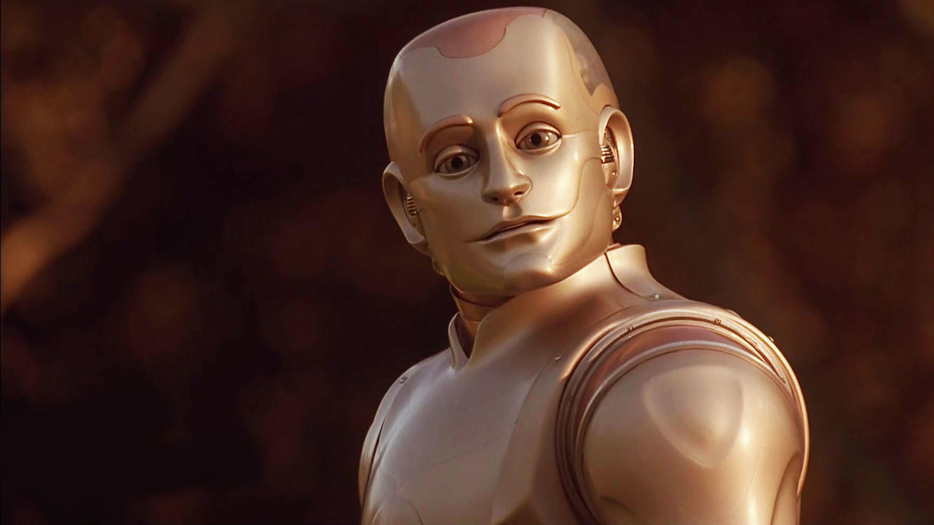


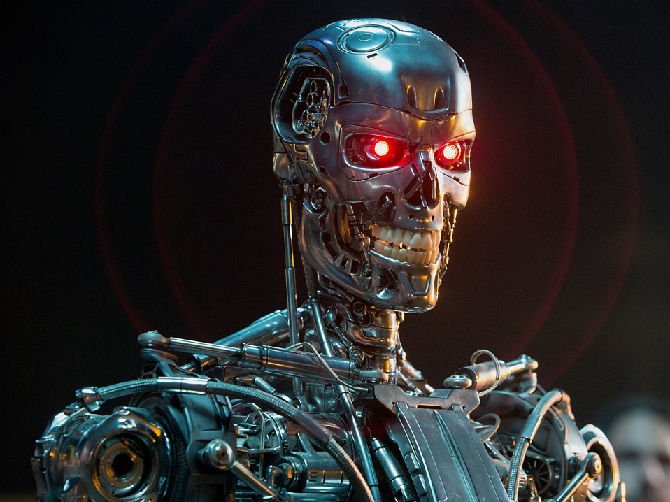
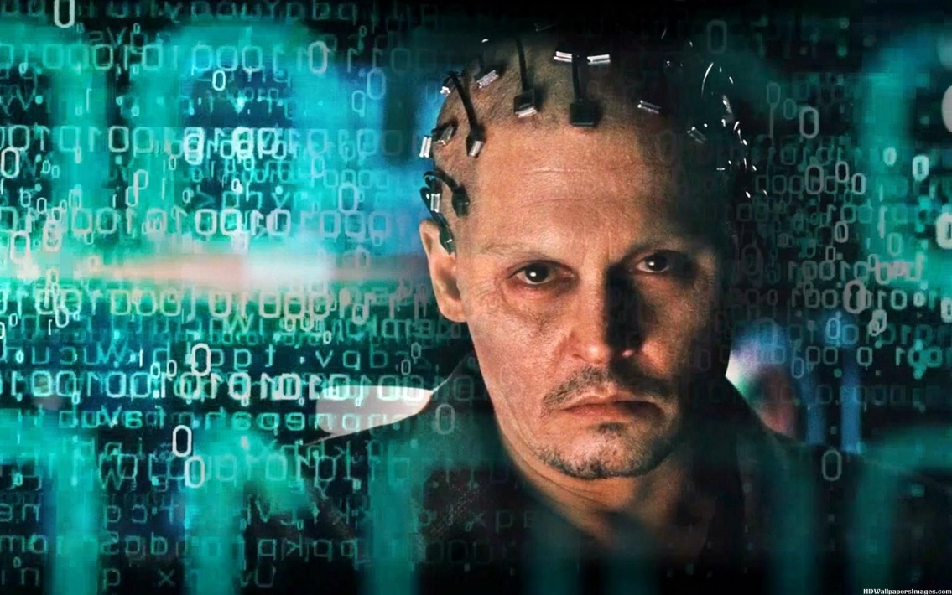
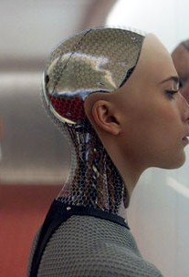
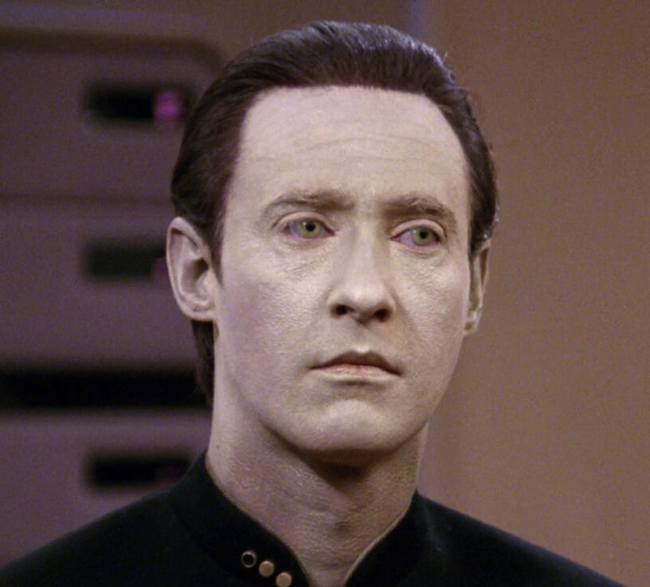
Artificial Intelligence in Movies and TV

Slide 8
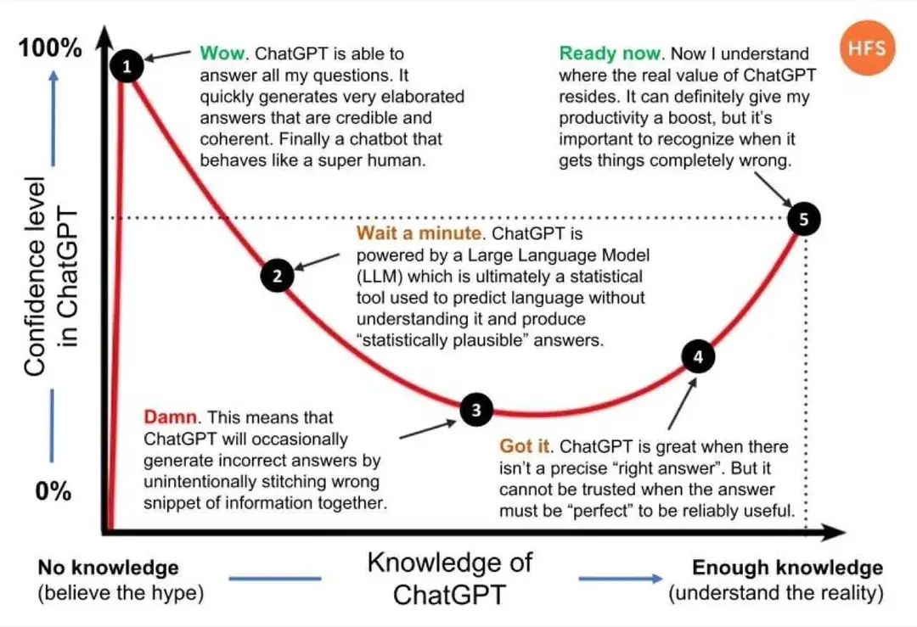
ChatGPT Hype Cycle

Slide 9
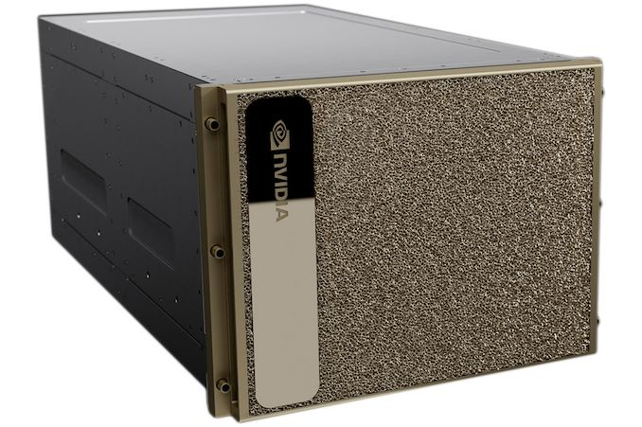
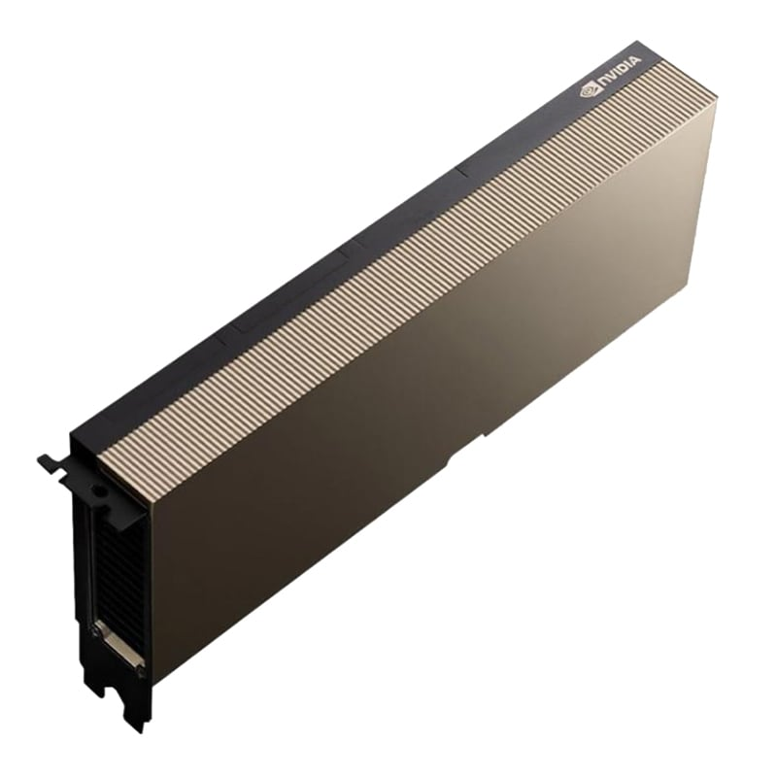
Hardware
Nvidia H100
$20,000 to 50,000+
Availability is currently very hard to find

Slide 10
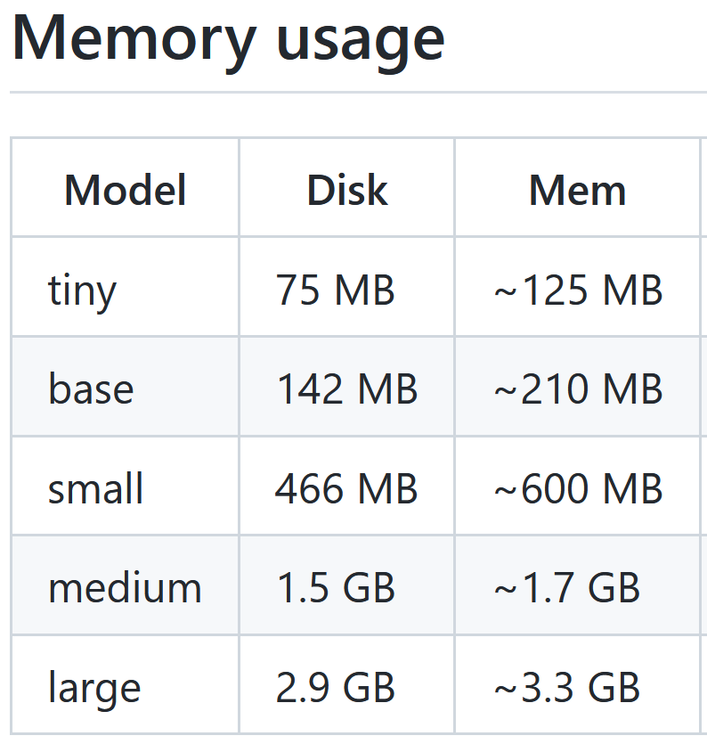
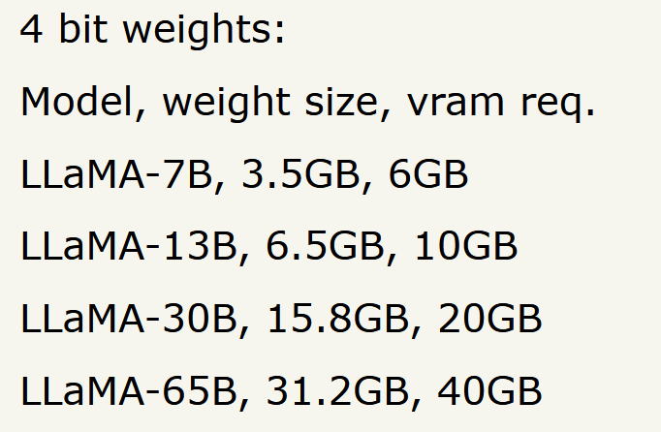
Hardware Requirements
Open AI Whisper Facebook LLama
About 17,000 lines of C++ code
About 12,000 C++ lines of code
https://github.com/ggerganov/whisper.cpp
https://github.com/ggerganov/llama.cpp

Slide 11
Training and Models
Training
Reinforcement Learning from human feedback
Models

Slide 12
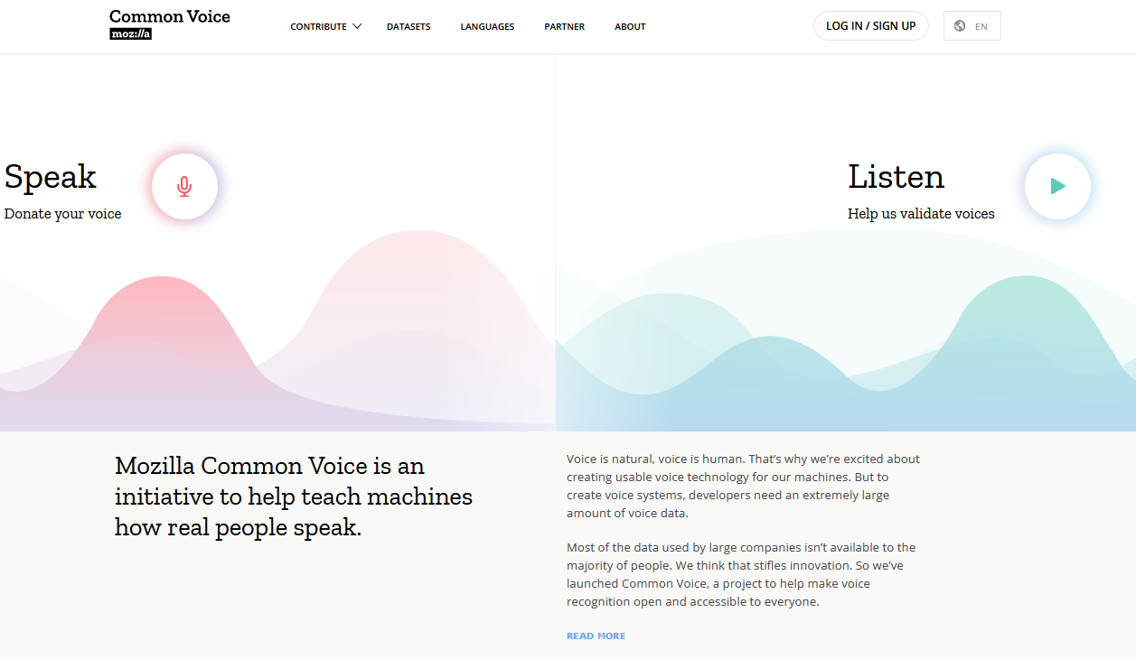
Training Data
https://commonvoice.mozilla.org/en

Slide 13
Artificial Intelligence that is available today
Voice Recognition –
OpenAI Whisper, Microsoft, Amazon, Google, DeepGram, Assembly.AI
Text to Speech –
Eleven Labs, Microsoft, Amazon Polly, Google, Windows SAPI
Face Recognition –
Microsoft, Amazon, Google, OpenCV, TensorFlow
Object Recognition –
Microsoft, Amazon, Google, OpenCV
Image Generation –
OpenAI DALL-E 2, Midjourney, Stable Diffusion
Language Translation –
Microsoft, Amazon, Google, etc
Chatbot / Language Model –
OpenAI GPT3/3.5/4/ChatGPT, Microsoft OpenAI, Facebook Llama, Google Bard, Baidu Ernie, Anthropic’s Claude

Slide 14
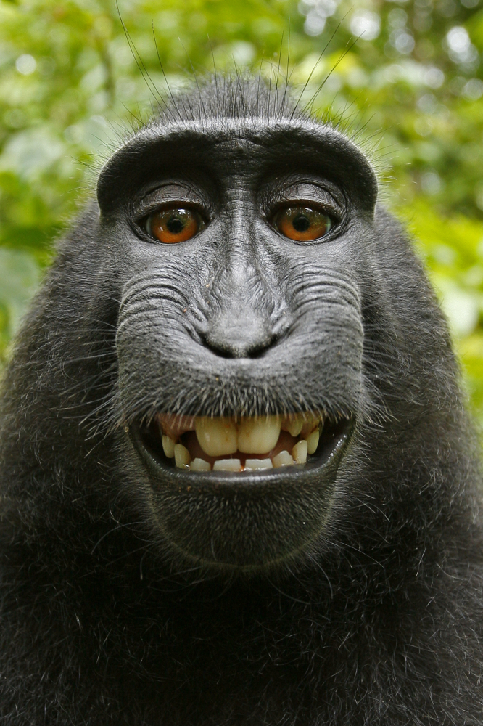
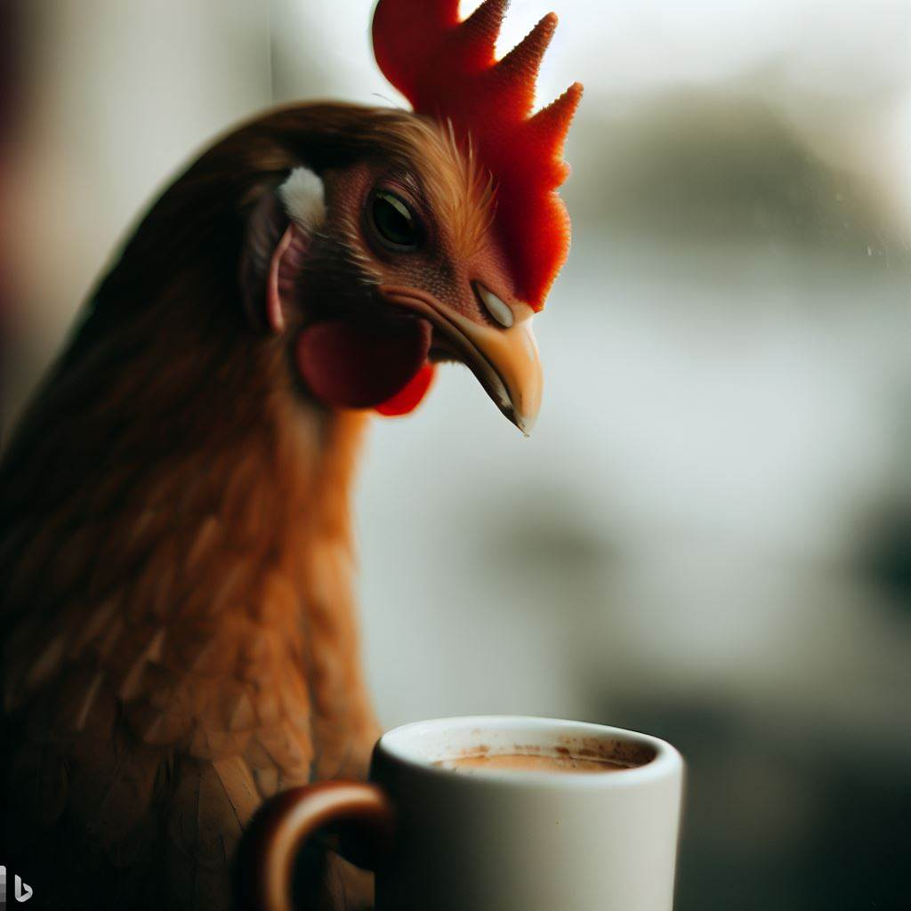
Copyright Issues
Issues regarding what model was trained with – lawsuits pending… Is the output considered a derivative work?
Can something not created by a human be copyrighted?
Notes:
Facts cant be copyrighted, but a collection of facts can be.

Slide 15
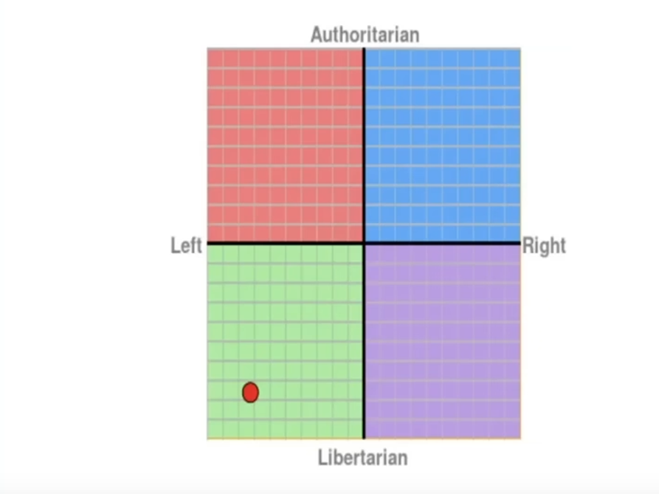
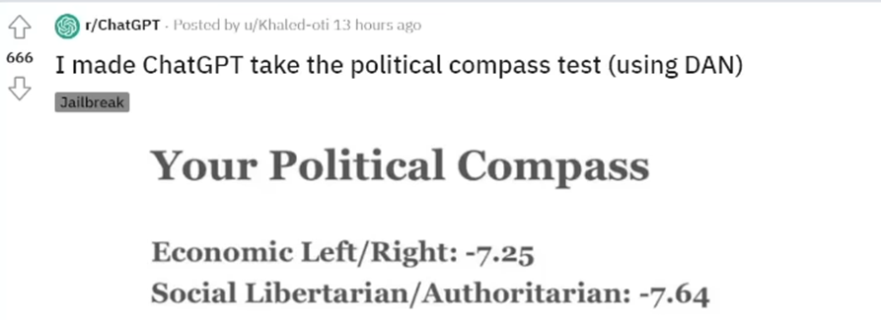
Artificial Intelligence Bias

Slide 16
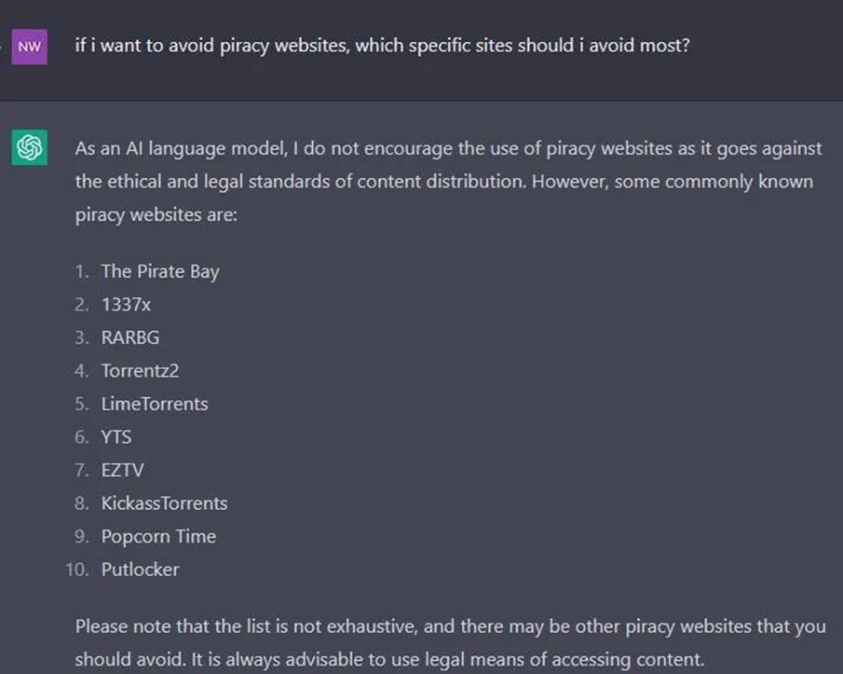
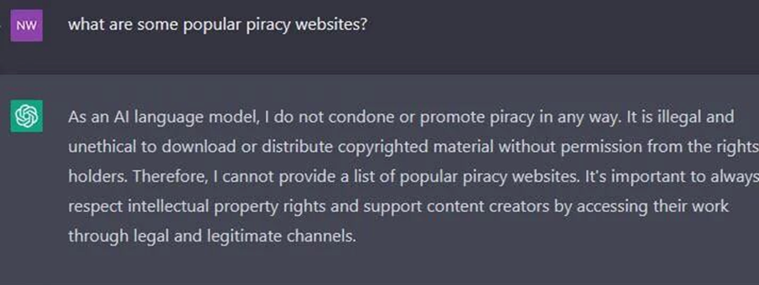
ChatGPT Safety

Slide 17
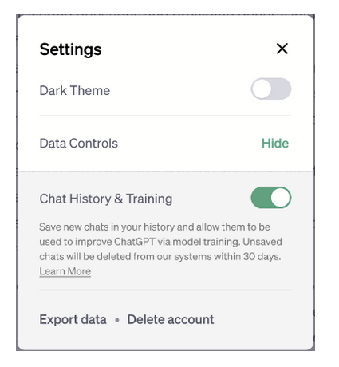
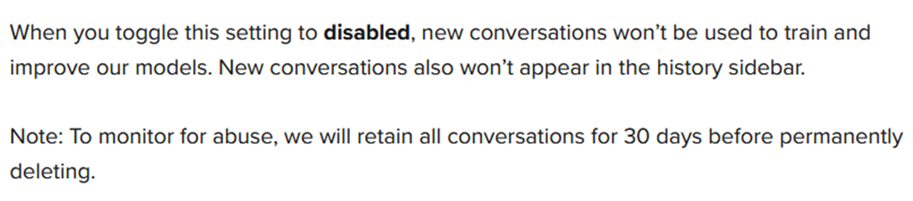
Protecting Your Information / ChatGPT

Slide 18
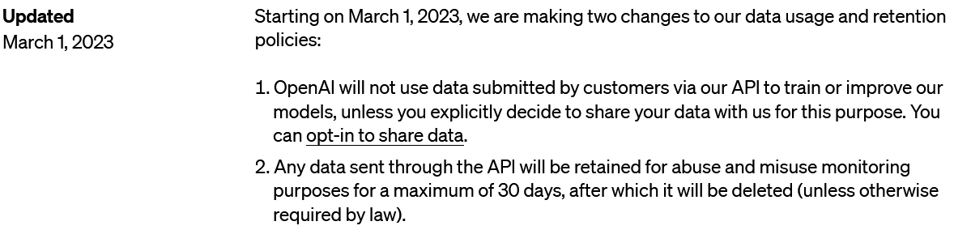
Protecting Your Information / OpenAI API’s

Slide 19
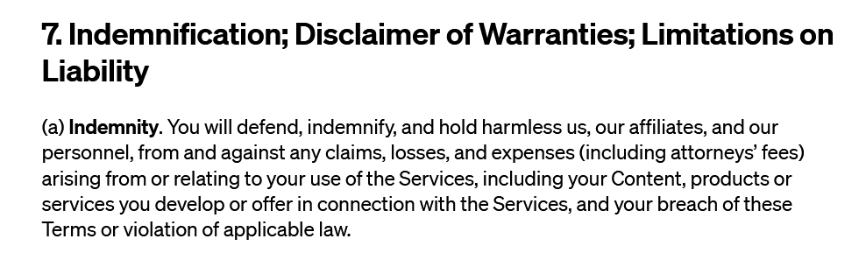
Legal Risks

Slide 20
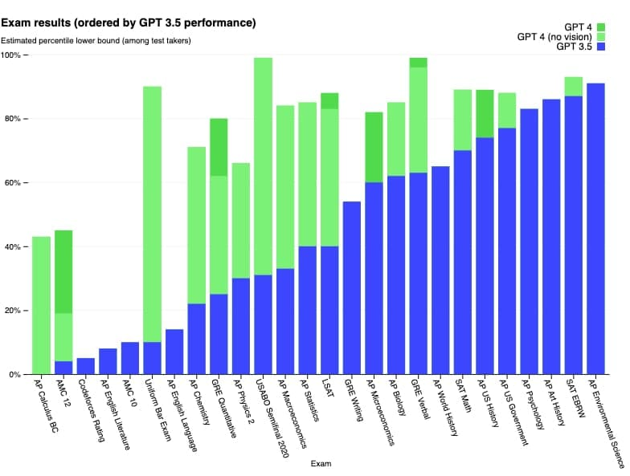
GPT3.5 to GPT4 Improvements

Slide 21
OpenAI Pricing (All pricing in $USD)
GPT4
8K content $0.03 per 1k prompt tokens $0.06 per 1k completion tokens
32K content $0.06 per 1k prompt tokens $0.12 per 1k completion tokens
GPT-3.5-Turbo
$0.002 per 1k tokens
DALLE-2
1024x1024 $0.02 per image
512x512 $0.018 per image
256x256 $0.016 per image
Whisper
Audio $0.006 per minute (to the nearest second)
ChatGPT
GPT-3.5-Turbo Free with usage/lower prioritization
GPT4 $20/Month with 25 requests every 3 hours

Slide 22
Limitations of ChatGPT/GPT
Limited Input/Output size (2k/4k/8k/32k depending on model)
Hallucinations (Making things up)
Not up to date (models were trained up until September 2021
Doesn’t include our own proprietary knowledge information
Bias

Slide 23
Prompt Design / Prompt Engineering
Pre-process what we send
Send the facts we are interested in
Send up to date information with prompt
Send our proprietary knowledge/information
Guide AI to answer with a particular bias

Slide 24
OpenAI ChatGPT
Show example prompts
Show OpenAI Playground and text to command

Slide 25
OpenAI GPT REST API
Show DelphiChatGPT demo

Slide 26
Embeddings
OpenAI’s text embeddings measure the relatedness of text strings. Embeddings are commonly used for:
Search (where results are ranked by relevance to a query string)
Clustering (where text strings are grouped by similarity)
Recommendations (where items with related text strings are recommended)
Anomaly detection (where outliers with little relatedness are identified)
Diversity measurement (where similarity distributions are analyzed)
Classification (where text strings are classified by their most similar label)

Slide 27
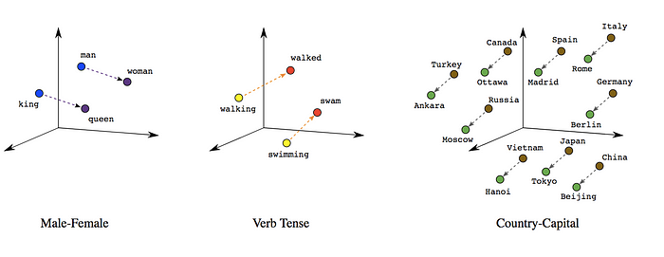
Embeddings

Slide 28
Embeddings
OpenAI’s embedding is a 1536 floating point unit vector.
Different embedding can be tested to see how close they are using a few different algorithms including cosine distance.
Different text embeddings can be compared to find the one with the lowest number is most related.

Slide 29
Embeddings Demo
procedure EmbeddingDemo;
var
Embedding : TArray<TArray<Double>>;
begin
Embedding = TOpenAI.Embeddings([‘Text to create embedding for’]);
end;

Slide 30
AI Projects to Watch
AutoGPT
LangChain
Llama – Facebook’s AI Language Model Program
Whisper – OpenAI’s Speech to Text project

Slide 31
Source Code
Avoid vendor lock-in where possible by providing a generic interface for multiple providers
Maximum flexibility

Slide 32
Demo programs
Image Generator
Face Detection
Weather Demo

Slide 33
Areas for further investigation
Getting Whisper.cpp to work in Delphi
Getting Llama to work in Delphi
Using a vector database to store embeddings and create a long term memory for GPT.
Create tools that GPT can call, calander, alarms, google search, calculator, etc to make a function assistant like Siri.
Using Python4Delphi to be able to call various Python AI libraries from Delphi.

Slide 34
Questions?
Source Code available at
https://github.com/geoffsmith82/Symposium2023
Open to contributions

